Slide 1
Smart Investor
Muhammad Haris-183187
Muhammad Umair Awan-183201
Muhammad Sibtain-183222

Slide 2
Outline
Problem Statement
Functional Requirements
Non-Functional Requirements
Use case Analysis
System Architecture
Development Tools and Technologies
GUI

Slide 3
Problem Statement
Our system can predict the Stock Market so that it can help the people where they can invest.
More than half of the country’s population 100 million adults ,lack access to the fundamental financial tools they need to manage their daily lives to grow their business.
According to Economist, by mobilizing their savings, Pakistani housewives can add USD 30Bn to Pakistan’s economy.
Our system intend to expand financial inclusion.

Slide 4
Smart Investor is an android based mobile application that aims to provide financial independence to the 160 million Smartphone users of Pakistan, majority of whom are students and women, particularly stay-at-home mothers.

Slide 5
Functional Requirements:
FR 01: Login
The system shall allow the user to enter the username/phone number.
The system shall allow the user to enter the password.
The system shall allow the user to click the “Sign in” button.
The system shall show a pop-up error message in case of a wrong email or password.
The system shall open the app after successfully login.
FR 02: Sign up
The system shall allow the user to enter his Email.
The system shall allow the user to enter their username and password.
The system shall allow the user to enter password and to confirm password.
The system shall allow the user to enter phone number
The system shall allow the user to click the “sign up” button.
The system shall show a pop-up error message in case of already used email/ mobile number or password
The system shall open the login page after successfully signup.

Slide 6
Functional Requirements:
FR 03: System Architecture
The system shall store user credentials such as username, password, Investment etc.
The front end should develop on Android Studio that is the user interface for our application.
The front end of the application shall allow the user to log in or create a new user profile and will prompt the user to enter his/her credentials and relevant details.
FR 03-01: Stock Market
The Stock Market shall concern with the collection, processing and prediction of stock market data.
The system should provide the stock market trend prediction of different companies.
The system shall show the recommended stocks to their users.

Slide 7
Functional Requirements:
FR 03-02: Pakistan Stock Exchange
The system shall take the data from Pakistan Stock Exchange.
The system should scrap live data of recent 8 weeks from PSX website.

Slide 8
Non-Functional Requirements:
NFR01: Performance
The regular load time of starting page of the scheme take fewer than 5 seconds.
Average system response time should not be greater than 5 seconds.
NFR02: Security
This application shall provide access to authorize user only via Log-in module.
A proper device shall be accepted in order to avoid any hackers, fake ids and unauthorized access.
NFR03: Usability
All authorize persons can easily access.
The system shall be easy to use.

Slide 9
Non-Functional Requirements:
NFR04: Recovery
The system should be good recovery scheme in situation of any tragedy.
NFR05: Availability
The application shall be available all the time and it should perform actions on all type of queries.
NFR06: Reliability
The system shall have high endurance level and safe switches which be activated if something goes wrong.
NFR07: Scalability
The system shall made to meet the future requirements and shall be made so that it can be improved in the future. It shall be dynamic not rigid. It shall be made to include new functions and features which will be the basic requirements in the future.

Slide 10
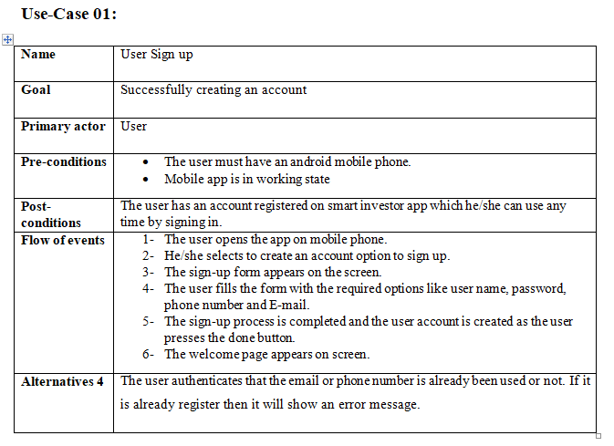
Use-Cases

Slide 11
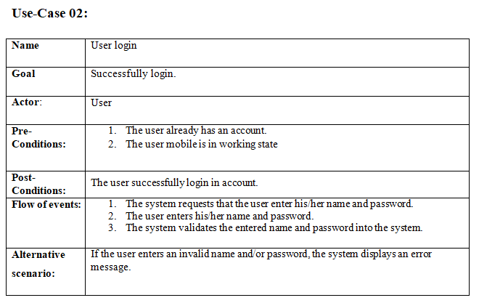
Use-Cases

Slide 12
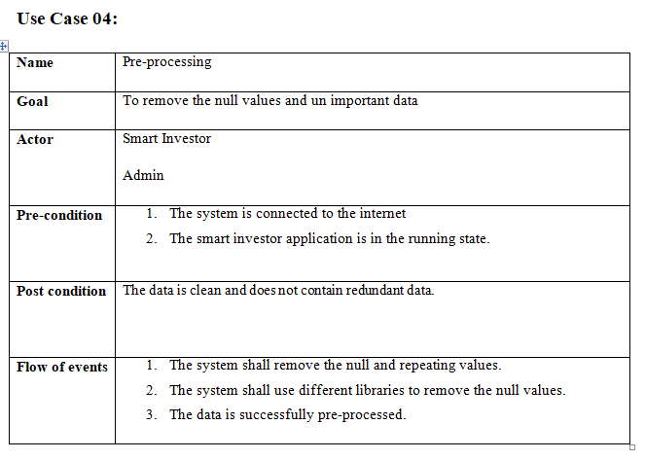
Use-Cases

Slide 13
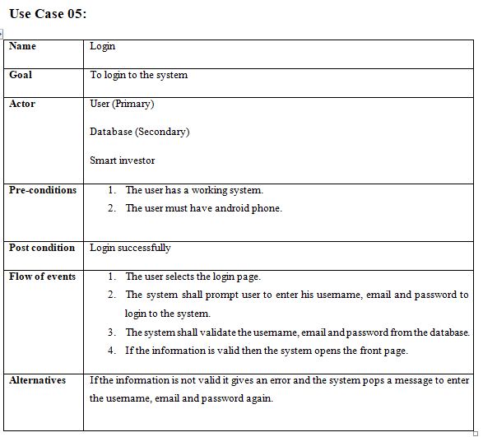
Use-Cases

Slide 14
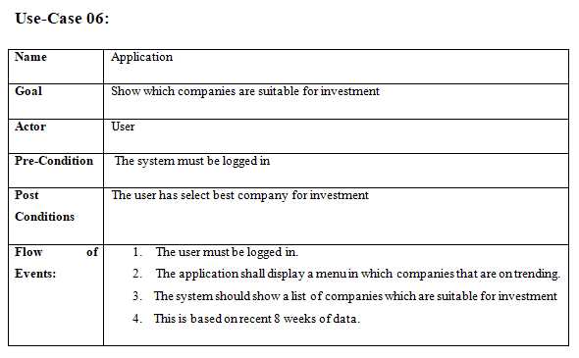
Use-Cases

Slide 15
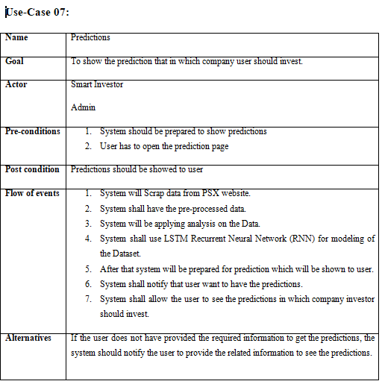
Use-Cases

Slide 16
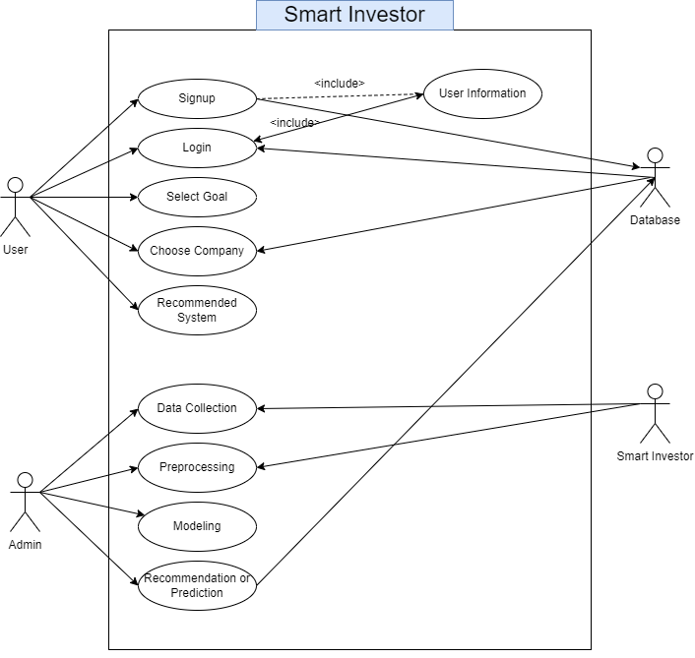
Use-Case Diagram

Slide 17
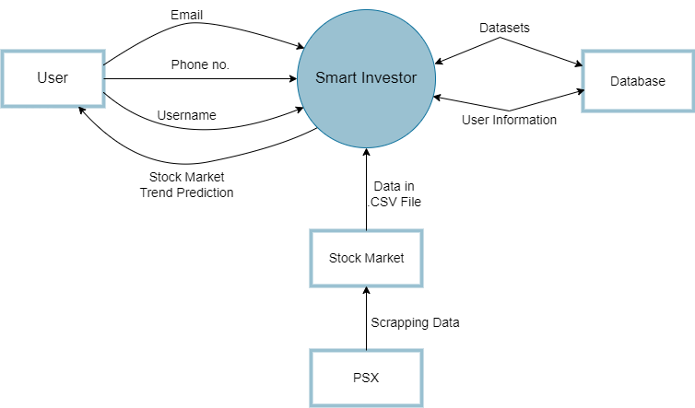
Architecture Design:

Slide 18
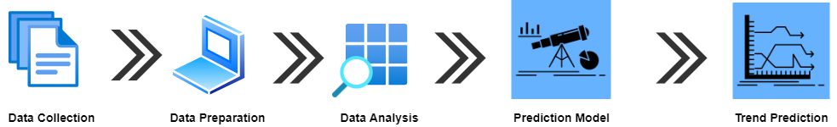
Methodology:
The following section contains information about the methodology we used to develop the Smart Investor project and application. The approach has been broken down into a number of subsections to allow for further comment on the subject.

Slide 19
Development tools and technologies:
Language: Python 3.8.0
DBMS: Firebase database
Client Side: Android Studio
Platform: pycharm

Slide 20
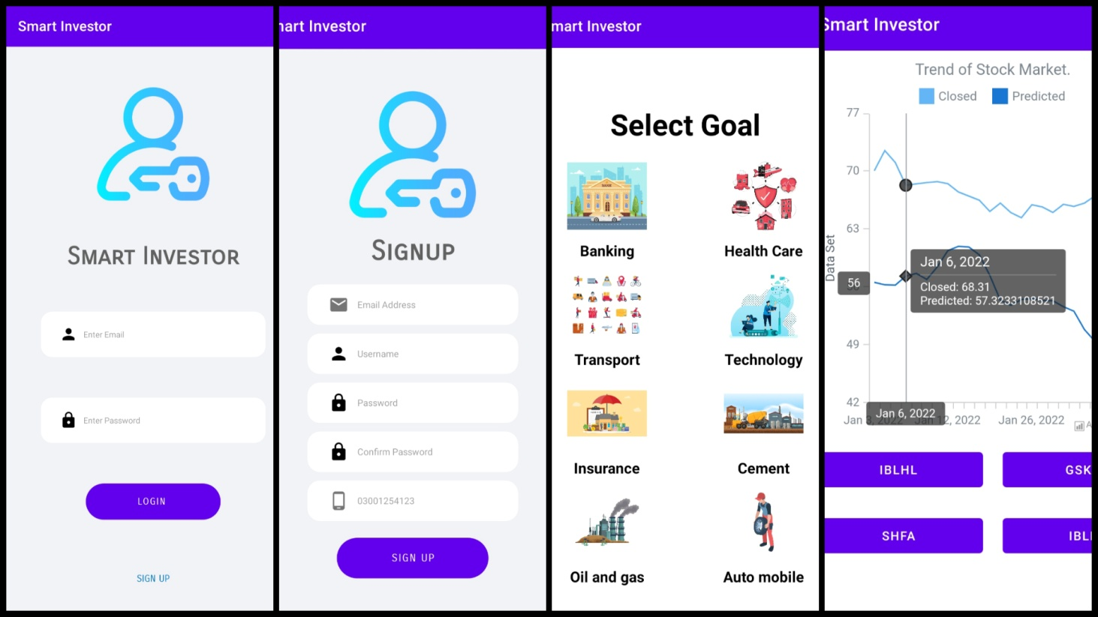
GUI

Slide 21
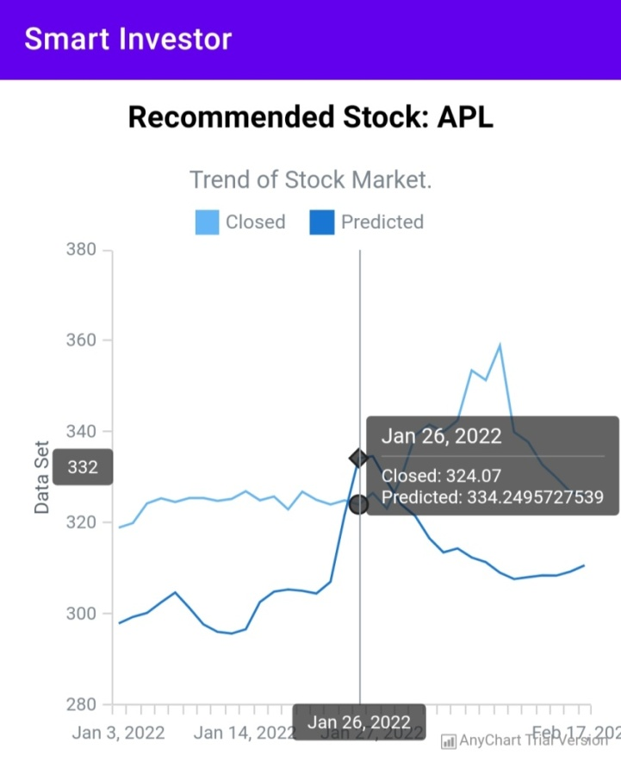
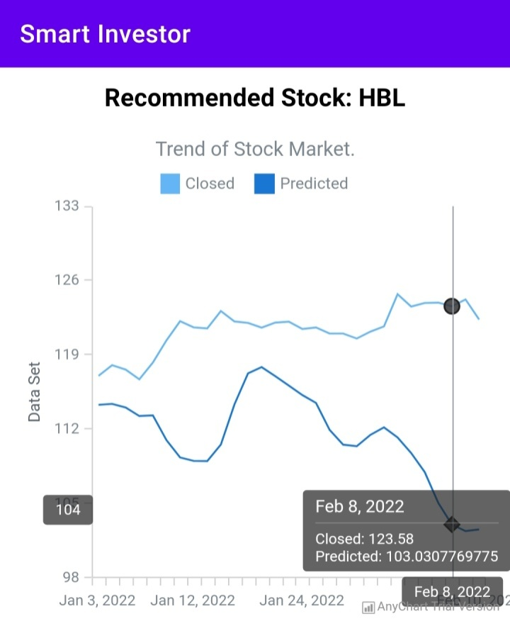
GUI-Prediction

Slide 22


